Slide 1
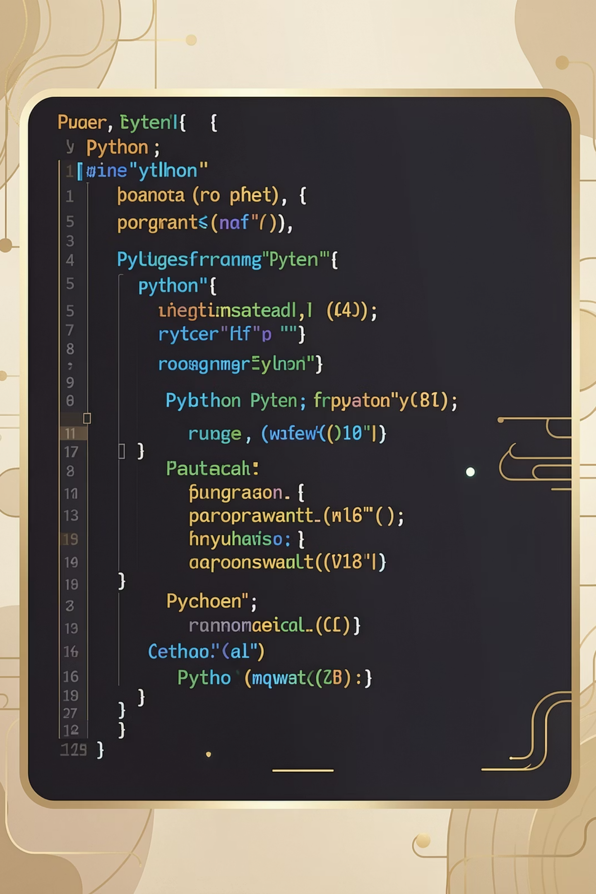
Python Internship Program
Zynkcode solutions — Learn. Build. Get Certified.

Slide 2

About Zynkcode solutions
SkillCertify is built to empower students with the skills, experience, and credentials they need to succeed in the tech industry.
Learn Programming Skills
Structured lessons from basics to advanced Python concepts
Build Real Projects
Hands-on tasks that mirror real-world development challenges
Gain Practical Experience
Work through industry-relevant problems and build your portfolio
Earn Certificates
Receive an official SkillCertify certificate upon completion

Slide 3


Internship Overview
Program Highlights
Mode
Fully Online — learn from anywhere at your own pace
Tasks
Practical-based assignments designed for real skill building
Levels
3 progressive levels — complete any 2 to earn certification
Certification
Official SkillCertify Certificate awarded after completion
Complete any 2 out of 3 levels to qualify for your certificate.

Slide 4
Task Structure
The internship is organized into three progressive levels, each building on the last. Choose any two to complete your certification journey.
Level 3 – Advanced
Level 2 – Intermediate
Mini projects, APIs, and CLI applications that demonstrate professional-level Python skills
Level 1 – Basics
Functions, modular programming, and file handling to build more structured applications
Foundational Python concepts including input/output, variables, and simple logic programs

Slide 5

Level 1 Tasks — Basics
Level 1 introduces the core building blocks of Python programming. These tasks are designed to get you comfortable with syntax, logic, and problem-solving.
🖨️ Basics
🧠 Logic
Print student details
Input/output programs
Simple calculator
Even/odd check
Largest number finder
Multiplication table

Slide 6
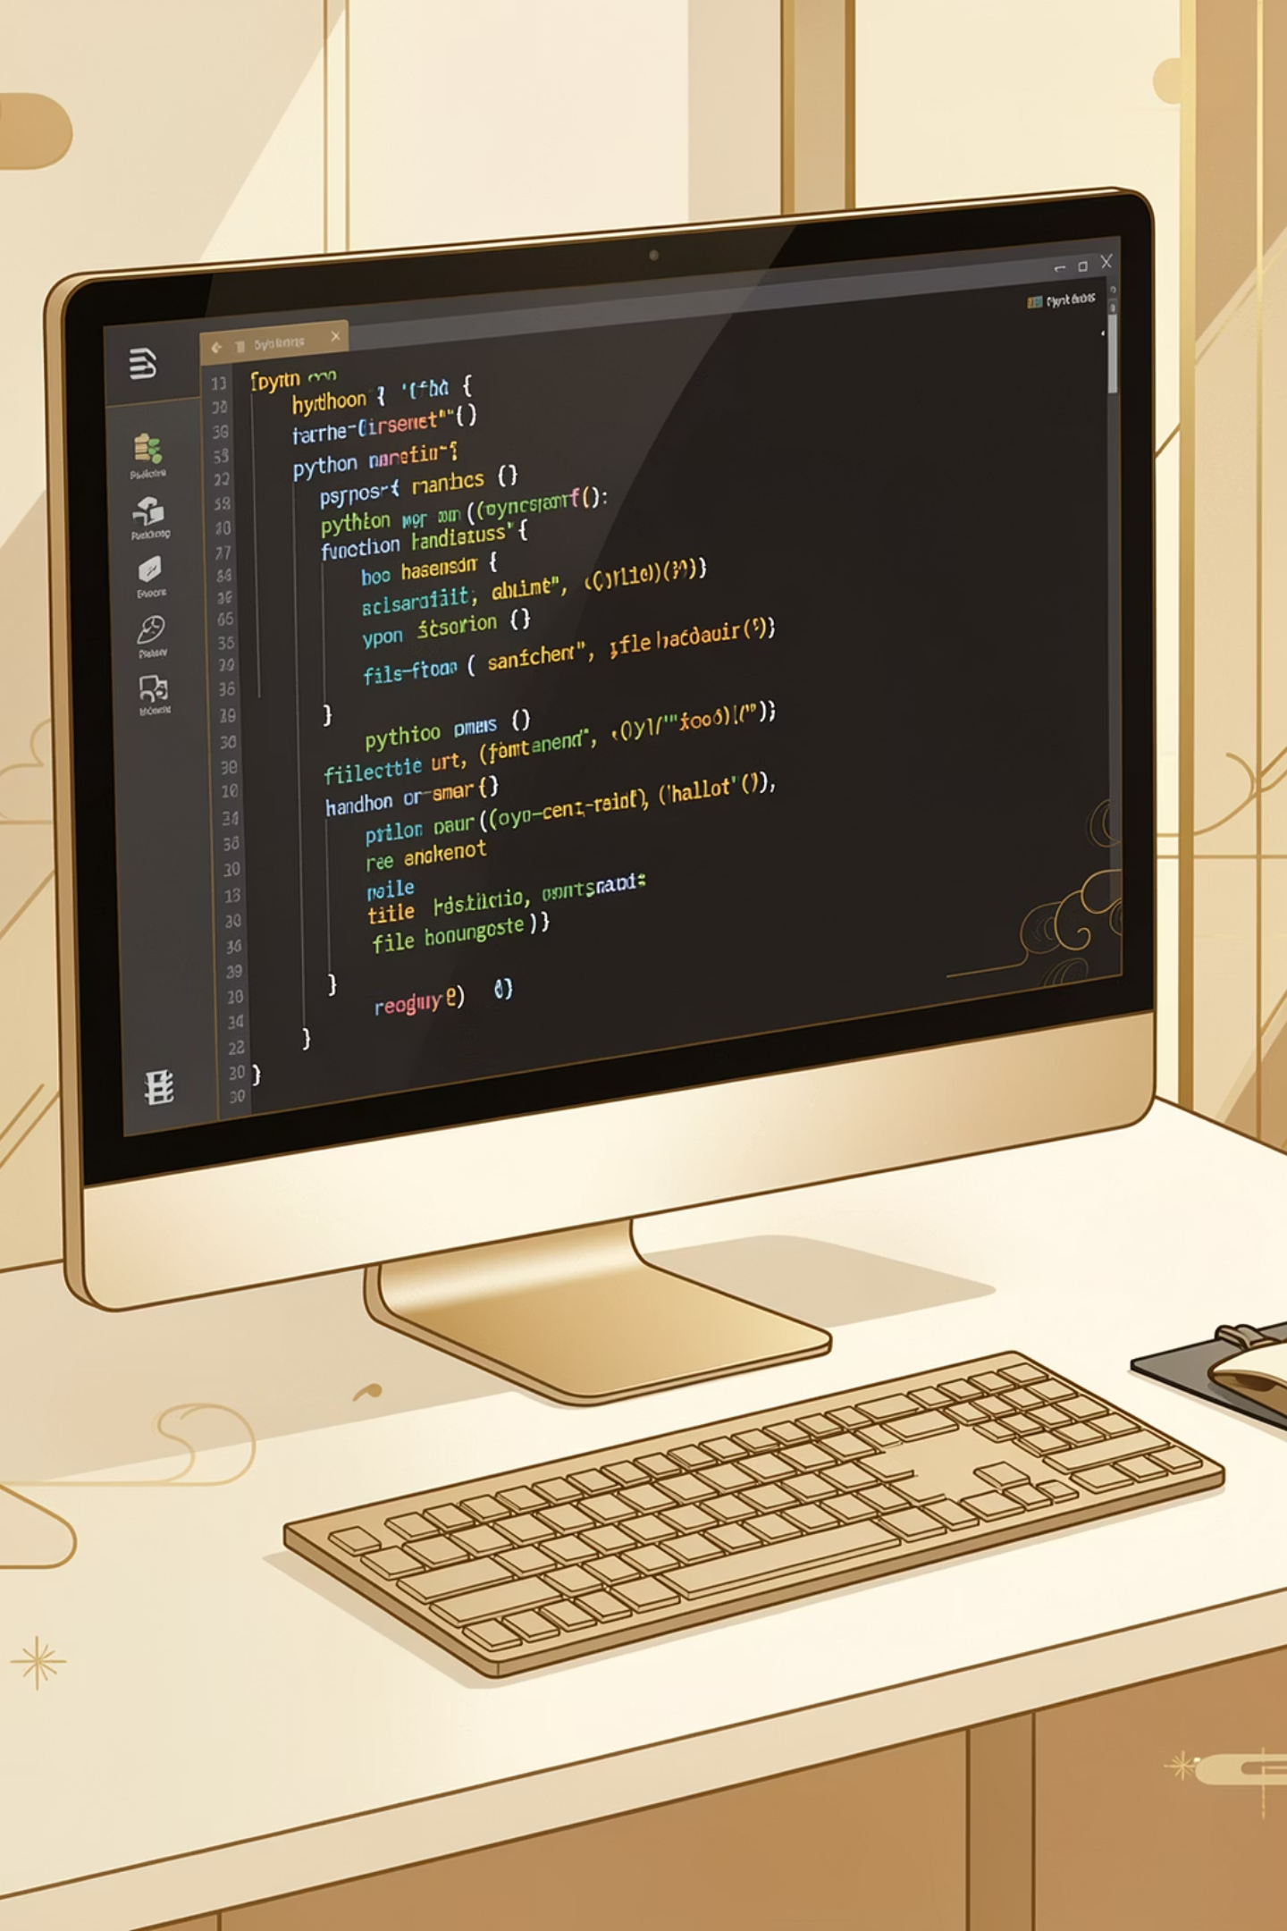
Level 2 Tasks — Intermediate
Level 2 elevates your Python skills by introducing functions and file handling — essential tools for writing clean, reusable, and practical code.
⚙️ Functions
📁 File Handling
Calculator using functions
Factorial program
Palindrome checker
Create a file
Write data to file
Read file contents

Slide 7
Level 3 Tasks — Advanced
Level 3 challenges you to build complete, functional applications and work with advanced Python capabilities like APIs and command-line interfaces.
Student Management System
Password Generator
Quiz Application
Create a secure, customizable password generator with user-defined parameters
Develop an interactive quiz app with scoring, timers, and multiple question types
Build a full CRUD application to manage student records using Python data structures
API Usage
CLI Application
Integrate external APIs to fetch and display real-world data in your Python programs
Build a command-line interface application with argument parsing and user interaction

Slide 8


Submission Process
How to Submit
Submitting your work is straightforward. Follow these three steps to complete your internship submission and move toward certification.
Once submitted, your work will be reviewed and your certificate will be issued promptly.
Submit Tasks
Record Demo
Upload Files
01
02
03
Submit All Tasks
Create a Demo Video
Upload to Platform
Ensure every task in your chosen levels is completed and ready for review
Record a short walkthrough demonstrating your projects and explaining your code
Submit your files and video through the SkillCertify platform for evaluation

Slide 9


Get Your zynkcode solutions Certificate
Completing the Zynkcode solutions Python Internship earns you an official certificate that validates your skills and boosts your professional profile.
Complete 2 Levels
Submit Your Tasks
Finish any two of the three available levels — Basics, Intermediate, or Advanced
Upload all completed tasks and your demo video to the SkillCertify platform
Receive Your Certificate
Get your official zynkcode solutions Python Internship Certificate — recognized by employers
Your certificate is a testament to your dedication, practical skills, and readiness for the professional world. Start your journey today!

Slide 10
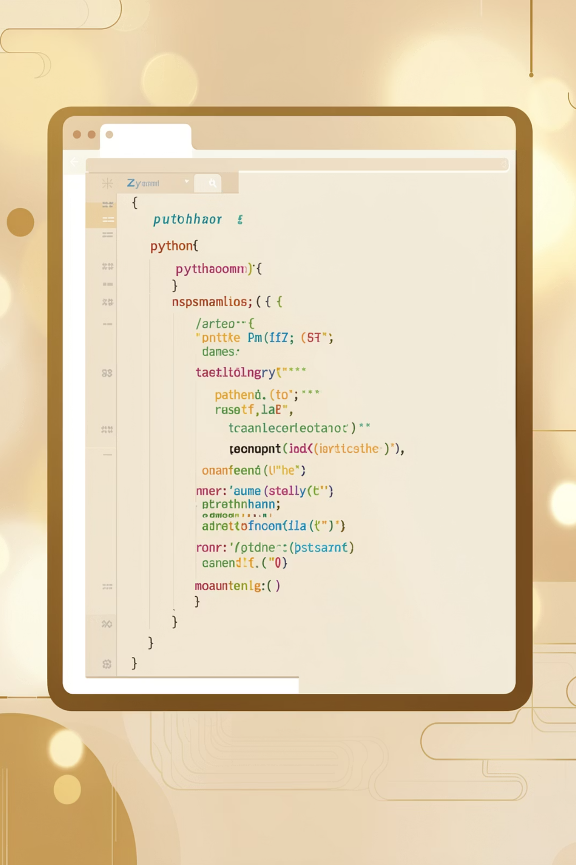
Start Your Python Journey Today
Join the SkillCertify Python Internship Program and transform your coding skills into a certified achievement.
3
2
Skill Levels
Levels Required
Progressive tasks from basics to advanced
Complete any two to earn your certificate
1
Certificate
Official SkillCertify credential upon completion
Learn. Build. Get Certified. — Your Python career starts here with SkillCertify.

